Slide 1
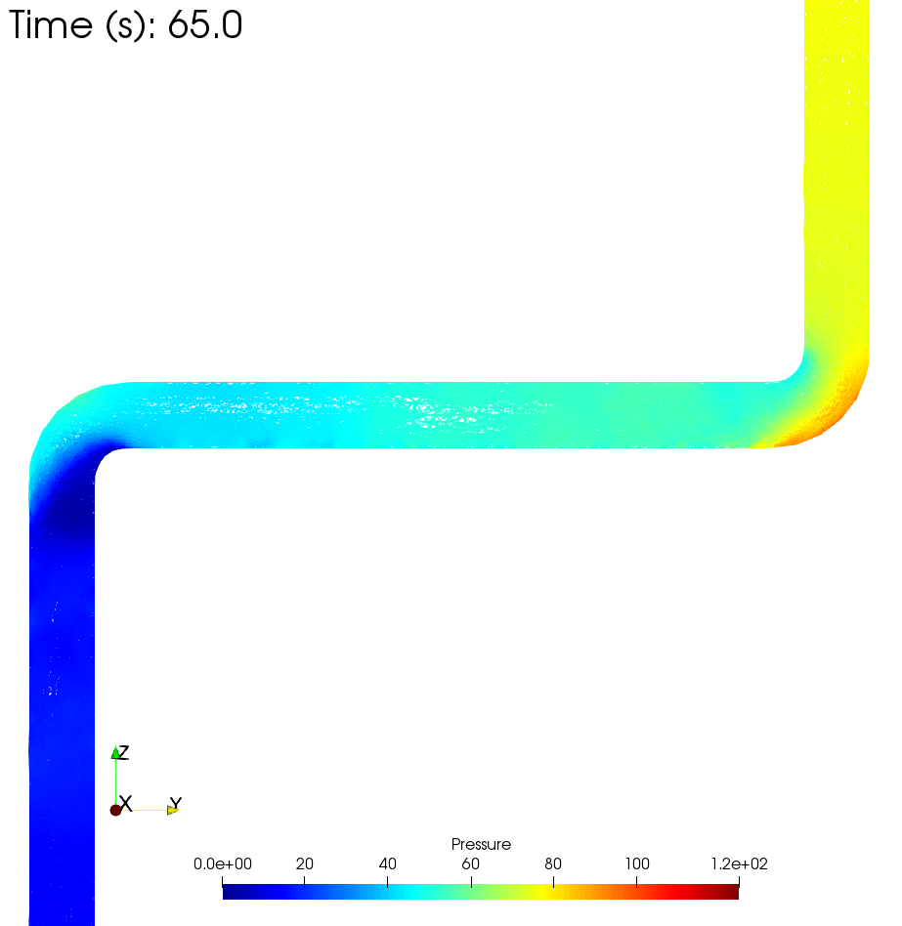
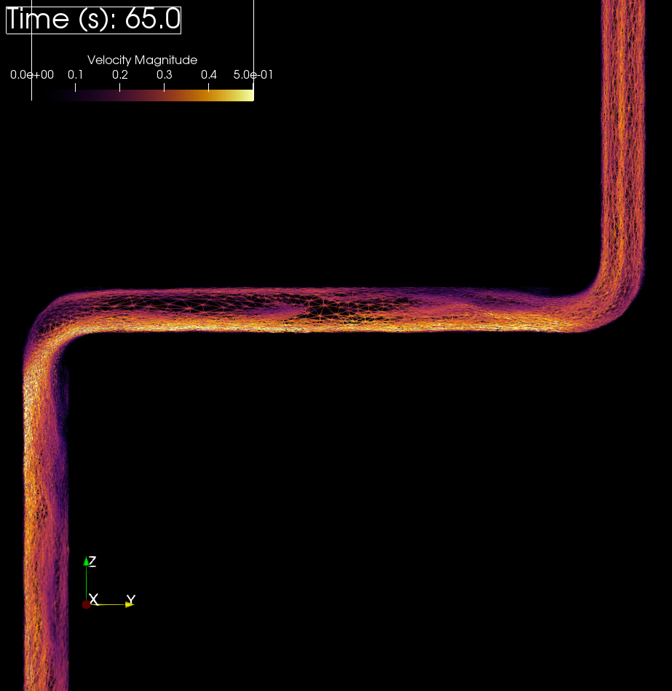
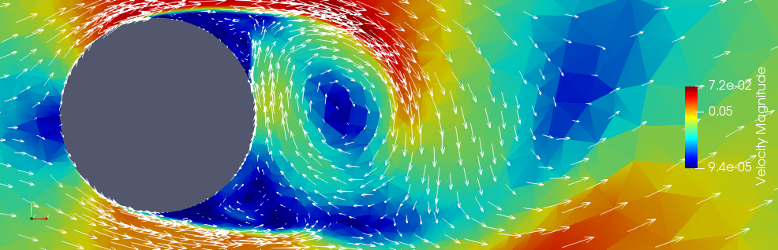
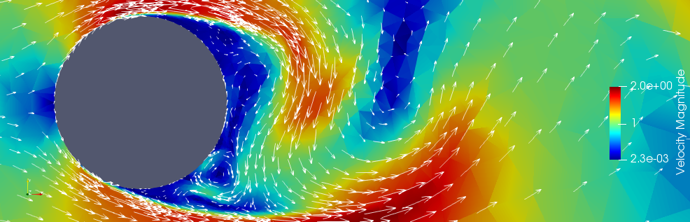
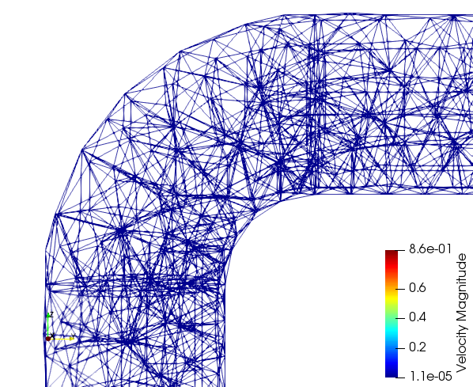
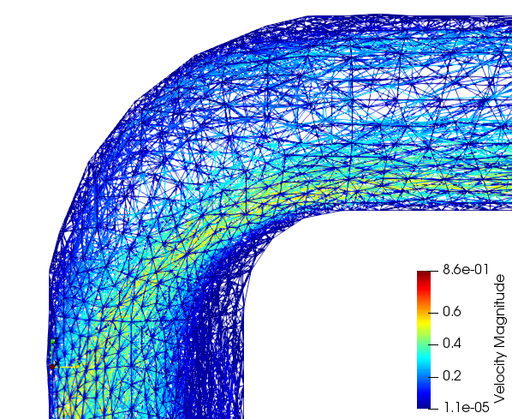
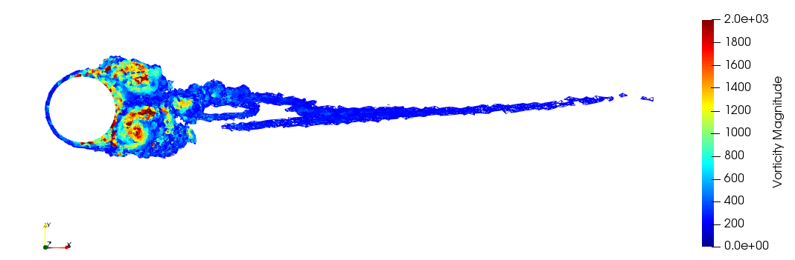
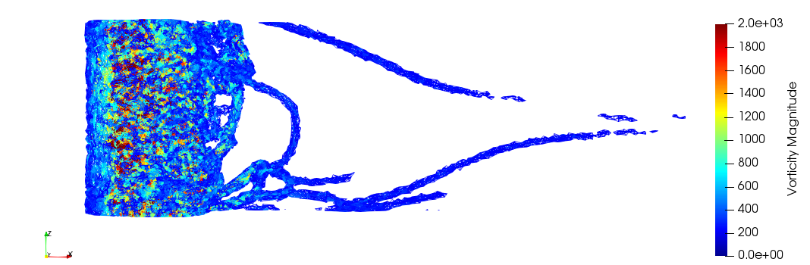
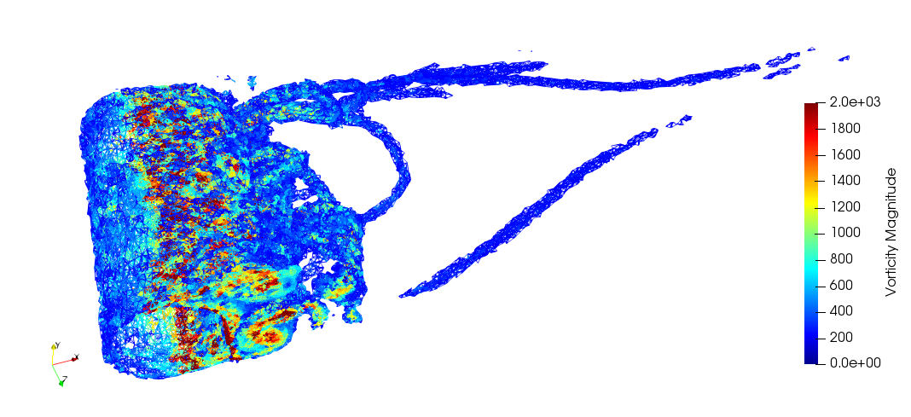


Improving Multiphase Computational Fluid Dynamics Capability using IC-FERST/Fluidity
UNDERPINNING TOOLS
PI(s): Prof. Christopher Pain
Co-I(s):
BP Mentor(s): Dr. Andre Nicolle
Researcher(s): Dr. Asiri I.B. Obeysekara
Introduction & Project Aims
Computational fluid dynamics (CFD) encompasses a range of methods and techniques that are widely adopted for fundamental work in both academia and industry. From aeronautics to energy sector, the development of state-of-the-art fluid modelling techniques are of important significance to vital applications, such as for prototyping and design, in scientific investigations, and engineering.
In the context of this project, the Oil and Gas industry are making increasing use of new techniques within CFD to model engineering scale processes to improve safety and increase productivity.
Industrial partners are often interested in research codes as they are often able to better represent and resolve multi-scale and multi-physics processes through the development of advanced techniques, such as dynamic mesh-optimisation¹, higher-order methods², and solid-fluid coupling³.
The project aims to evaluate and improve the modelling capabilities of BP in the context of Oil and Gas using advanced, research-led CFD code IC-FERST/Fluidity developed in Imperial College London.
Results & Discussion
Experimental
Results & Discussion
Results & Discussion
IC-FERST is a computational fluid dynamics modelling code developed in the Applied Modelling and Computation Group (AMCG) in Imperial College London (ICL). The code is based on a Control-Volume Finite-Element Method (CV-FEM)² and has been used for a wide variety of applications within Earth Science and Engineering.
The code has been parallelised using MPI and has been on high-performance computing clusters in industry and academia. Here we demonstrate IC-FERST modelling turbulent single-phase flow using unstructured adaptive mesh optimisation and state-of-the-art numerical technology. Two cases have been identified as appropriate to validate and benchmark IC-FERST applicability to applications relevant to industry and BP CFD workflows. The schematically representations of the simulation domains are presented below in Fig.1 and Fig.2.
1. Flow Past A Cylinder
2.Turbulent Flow in a bent pipe
Single phase transient flow around a long cylinder and single-phase flow in a pipe have been modelled using IC-FERST in serial and parallel. The results are presented below.
Flow past a cylinder
A preliminary investigation was conducted in the form of a 2D and 3D simulation of flow past a cylinder flow (Fig 3 and 4 respectively). The adaptive mesh optimisation has been demonstrated to successfully resolve the turbulent eddies and near wake region, while coarsening the mesh in laminar.
(2D)
(3D)
Single phase pipe flow
The preliminarily results from modelling Re=100000 flow in a pipe using IC-FERST are presented below in Fig 5 where pressure and velocity at 65 seconds, as turbulent eddies start developing at the two 90° bends. The meshes from the results highlight dynamic mesh optimisation resolving well on velocity starting from an initial coarse mesh (Fig 6)
(A)
(B)
(A)
Re = 3900
Adaptive mesh on velocity
(B)
Re = 100 000
Adaptive mesh on velocity
Figure 5 – (A) Pressure and (B) velocity of single-phase flow in a pipe at T=65 seconds
(A)
(B)
TOP
W=πD
Figure 3 – Velocity colouring and glyphs of turbulent flow around a cylinder modelled using IC-FERST for (A) Re=3900 and (B) Re=100,000
SIDE
D=0.01 m
SIDE VIEW
Re = 3900
Adaptive mesh on velocity
H=30D
Figure 6 – Visualising the adaptive mesh and velocity at time (A) initial T=0 s and (B) T=65 seconds for Re=100000
TOP VIEW
Re = 3900
Adaptive mesh on velocity
REFERENCES
Pain, C. C., Umpleby, A. P., de Oliveira, C. R. E. & Goddard, A. J. H. 2001 Tetrahedral mesh optimisation and adaptivity for steady-state and transient finite element calculations. Computer Methods Appl. Mech. Eng.190, 3771–3796. (doi:10.1016/S0045-7825(00)00294-2)
Salinas P, Pavlidis D, Xie Z, Osman H, Pain CC, Jackson MD et al., 2018, A discontinuous control volume finite element method for multi-phase flow in heterogeneous porous media, JOURNAL OF COMPUTATIONAL PHYSICS, Vol: 352, Pages: 602-614, ISSN: 0021-9991
Obeysekara A, Lei Q, Salinas P, et al., 2018, Modelling stress-dependent single and multi-phase flows in fractured porous media based on an immersed-body method with mesh adaptivity, Computers and Geotechnics, Vol:103, ISSN:0266-352X,
B. N., Rajani & Kandasamy, A & Majumdar, Sekhar. (2016). LES of Flow past Circular Cylinder at Re = 3900. Journal of Applied Fluid Mechanics. 9. 1421-1435. 10.18869/acadpub.jafm.68.228.24178.
Li=5D
Lo=25D
Figure 1 – Schematic of 3D flow past a cylinder investigation from a 30D x 30D x πD domain from Rajani et al (2016)⁴
10 m
3D VIEW
Re = 3900
Adaptive mesh on velocity
5 m
Figure 2 – Schematic of pipe with two 90° bends for simulation of single phase turbulent flow (Re 100,000)
0.5 m
Figure 4 –Instantaneous snapshot visualising vortex structure of the developed turbulent flow around the cylinder from three views
10 m
Ultimate goals
Evaluate the effectiveness and robustness of numerical methods and technologies in IC-FERST/Fluidity, such as mesh optimisation, for CFD problems of importance to BP.
Build and optimise the performance of the code for CFD in the HPC owned by BP. Designing and implementing workflow to be used for CFD by BP.
Investigation of single- and multi-phase, turbulent flow, CFD applications using IC-FERST/Fluidity for industrial applications of interest to ICL and BP researchers.
ICAM62 Date: June 2019

